Slide 1

GE InSight
Reporting Microservices & APIs

Slide 2
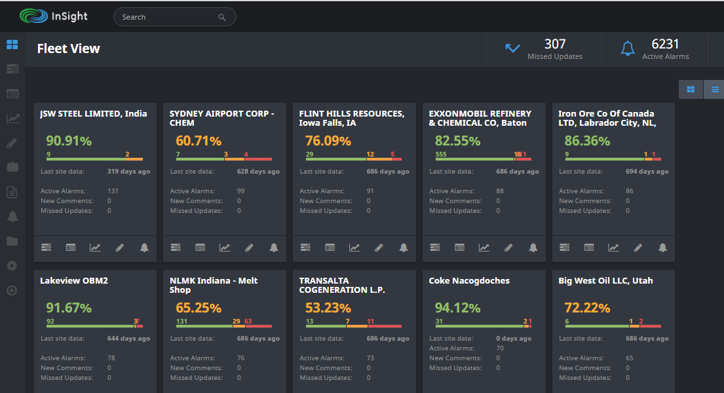
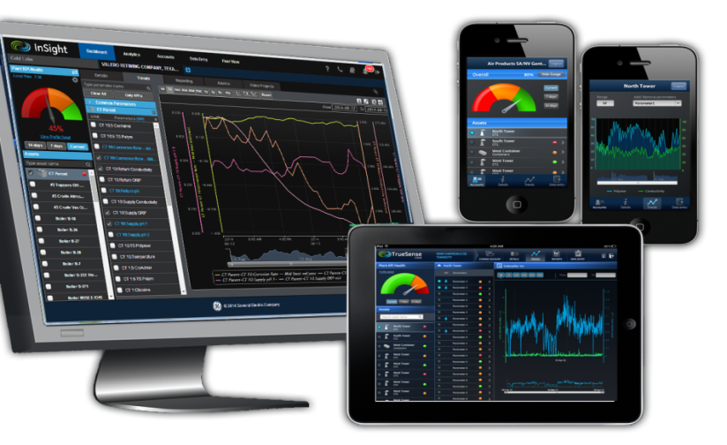
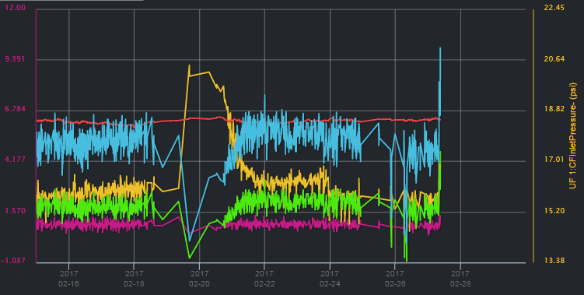
What we do
InSight® is a mobile and web-based IOT platform that enables remote monitoring, diagnostics and analytics of customer Assets
Features :
Asset management and Monitoring
Alerting
Data Visualization
Analytics
Reporting
Inventory management
ERP integration

Slide 3
Solution Context
The customer was looking to
Modernize functionality in InSight by transforming existing functionality to cloud-native, hyper-scalable microservices with secure, scalable APIs that provide GE’s customers, users, and Predix developers standards-compliant programmatic access to capabilities and functionality through RESTful APIs
Initial focus area: Reporting
Enhance reporting to support the following additional use cases:
Build a reporting solution that can be used by other businesses across GE.
Delivery of reports to external systems through standards-compliant Web-based integrations: event notifications/web hooks, HTTPS posts, etc.

Slide 4
Microservices Approach
Current Approach
Microservices Approach
UI
UI
Application Services Layer
APIs
Middle Tier Application
Code
Microservices
Data Services
Platform Services
Backend Dependencies
Backend Dependencies
Infrastructure
X
X
X
X
X

Slide 5
Microservices Approach
Microservices architecture enables:
Rapid, low impact evolution & replacement
Robust fault isolation
Deployment automation & flexibility
On-Demand Scalability
Small Testing Scope
Simple Optimization
Flexible Versioning
Shortened time-to-value
Cost efficiency is improved by leveraging cloud computing economies of scale and reducing the need to manually operate and maintain server infrastructure

Slide 6
Microservices Transformation Process
InSight
Microservices Platform
Extract “vertical slice” of application functionality
1
Platform Security
2
UI
Package as Microservice(s)
API Security
API Layer
Microservice 1
Microservice 2
Microservice n
UI
UI
UI
Expose functionality through APIs
Application Services Layer
APII
API
API
4
Logic
Logic
Logic
Data
Data
Data
3
Deploy on Microservices Platform
Microservice 1
Microservice 2
Microservice n
Middle Tier Application
Code
$
…
Usage Metering
Billing & Chargeback
Data Services
Platform Services
Backend Dependencies
Backend Dependencies
Infrastructure

Slide 7
Reporting Architecture on Insight
Web
Mobile
PUBLIC
v
Reporting Server
101010
010101 101010 010101 101010
Report Storage
Reporting Web Service
Reporting Engine
Report
Generation Workers
Report Distribution
PRIVATE
Reporting Engine
Secure Email
Time Series data (Cassandra )
Asset Data(Oracle)

Slide 8
Reporting Architecture on Predix
Web
Mobile
Predix Platform
PUBLIC
Time
Series
Data
Asset Data
Reporting APIs
Elastic BLOB storage
101010
010101 101010 010101 101010
v
Report Blueprints
Report Templates
Report Definitions
Report Schedules
Report Generation
Report Distribution
PRIVATE
HTTPS WebHooks/
Notifications
Report
Generation Workers
Generated Reports
Secure Email
Other
Delivery
Channels…
LEGEND
Public API (Existing)
Public API (New)
Private API (New)

Slide 9
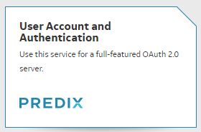

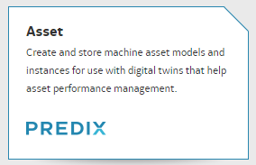
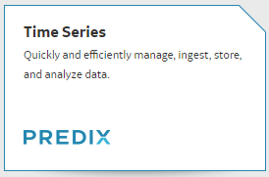
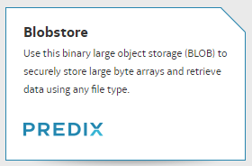
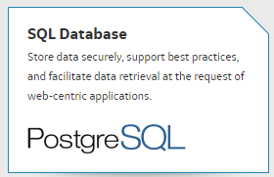
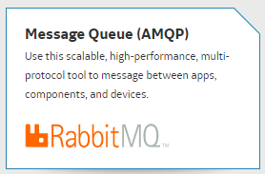
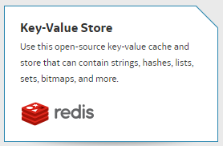
Reporting Components Architecture on Predix
Reporting UI
Asset Model Service
Reporting Core API
Report Generation
Report Management
Predix
Platform
Blob Store service
Report Generation Workers
Time Series Service
Scheduler
Data Management
Predix
Asset Data
Predix
Time Series
Predix
Blobstore
Predix
PostgreSQL DB
Predix
Rabbit MQ

Slide 10




Tools / Software
Predix UI - px-data-table
PolymerJs
Python
Flask - python microservices
ReportsLab
Java Spring Boot - Scheduler

Slide 11
Anticipated Outcomes
Reporting functionality is elastically scalable, leveraging cloud based infrastructure to automatically scale up and down as required, increasing infrastructure efficiency and reducing exposure to operational risks such as performance problems, scaling challenges, and service unavailability
Functionality improvements around reporting are in place:
Reports are able to be delivered to external systems through standard Web based delivery mechanisms, email
Multi-Site Reporting
Continuous Integration and Delivery practices for version control, inspection automation, build automation, test automation, and deployment automation are in place and operational for reporting and for all new services created, minimizing time and manual effort required to deliver new functionality.

Slide 12
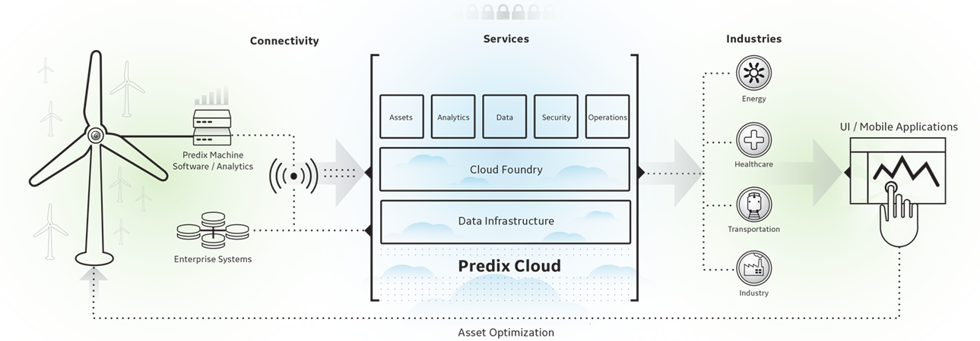
Predix Cloud Platform
Platform for future of all GE applications and services
Built on Pivotal Cloud Foundry PaaS
Microservices-based architecture
Pre-built templates & accelerators
UI components for Web & Mobile
Rich services ecosystem
Data Management Services
Asset Data - create and store machine asset models
Time Series - Manage, ingest, store and analyze data
SQL Database - PostgreSQL
Key-Value Store - redis - key-value cache and store
AMQP - RabbitMQ - messages between apps, components and devices
Blobstore - Binary large object storage
Security Services
User Account & Authentication
Access Control Service - Robust access control
Tenant Management - instance provisioning for tenants and runtime access
Analytics Services
Analytics Catalog
Analytics Runtime - elastic execution
Analytic User Interface - to upload, validate, and run analytics
GeoEnhance - pitney bowes - for location services
Edge Software & Services
Machine - enables machine to machine, machine to cloud, and machine to human connectivity
Edge Manager - Deployment and Monitoring
Connectivity - plug-n-play, secure, and reliable connectivity services
Commercialization Services
Business Operations - nurego - to monetize services using subscription mgmt., profitability analysis, and customer segmentation
App Services
Views - Control layout and component for UI
Workflow - azuqua - for workflows between apps
Resources – App Dev Tools
DevBox - Predix-ready bundle of preinstalled and preconfigured app development tools
Buildpack - Cloud Foundry - Cloud Foundry compatible buildpacks
Machine Data Simulator - generate time series test data series, Machine, Analytics and Visualization
DevOps Services
Logging - Logstash - log, save, search, and visualize logs
Mobile Services
Mobile SDK - quickly build mobile apps to monitor, service, and maintain assets
Mobile Service - design, develop, and deploy mobile apps

Slide 13
DEMO

